Slide 1

Social Deprivation Index, Food Access, and Obesity
By Paul Walter

Slide 2
Obesity
What is it?

Slide 3
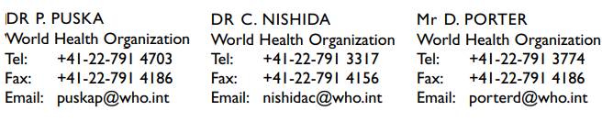
Obesity is…
Obesity has reached epidemic proportions globally, with more than 1 billion adults overweight - at least 300 million of them clinically obese - and is a major contributor to the global burden of chronic disease and disability. Often coexisting in developing countries with under-nutrition, obesity is a complex condition, with serious social and psychological dimensions, affecting virtually all ages and socioeconomic groups.
Increased consumption of more energy-dense, nutrient poor foods with high levels of sugar and saturated fats, combined with reduced physical activity, have led to obesity rates that have risen three-fold or more since 1980 in some areas of North America, the United Kingdom, Eastern Europe, the Middle East, the Pacific Islands, Australasia and China.
Link

Slide 4
Poverty and Food Environment
What is it, and why is it Important?

Slide 5
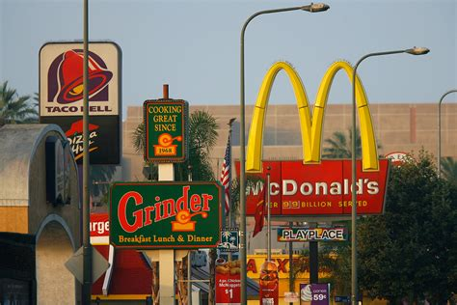
Food Environments (Deserts and Swamps)
Link

Slide 6
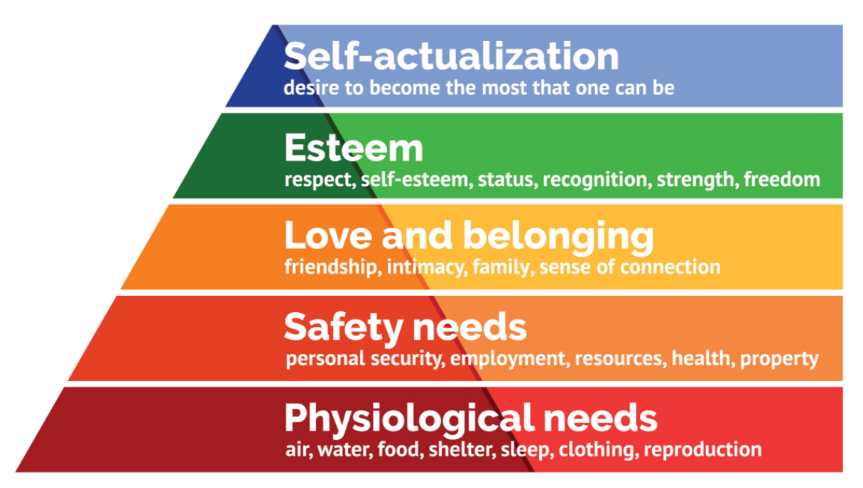
It recognizes a pattern, but there could be better indicators for this Maslow Hierarchy of Needs

Slide 7
Social Deprivation Index
What is it?

Slide 8
1979. Peter Townsend
Sociologist from the UK, created the index to measure how poverty is expressed via inequality.
It incorporated four variables originally:
Unemployment (as a percentage of those aged 16 and over who are economically active);
Non-car ownership (as a percentage of all households);
Non-home ownership (as a percentage of all households); and
Household overcrowding.

Slide 9
SDI Major Aspects
Material Deprivation
Social Deprivation

Slide 10
Why is it useful?
Poverty is Invisible
Deprivation can be cumulative

Slide 11
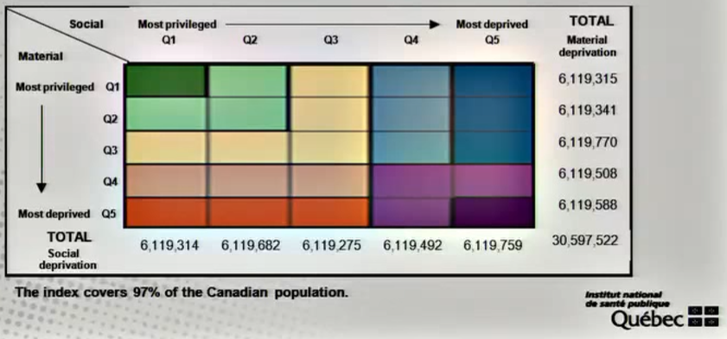
But can be less so with the right tools
It can provide a more intuitive look at inequality.

Slide 12
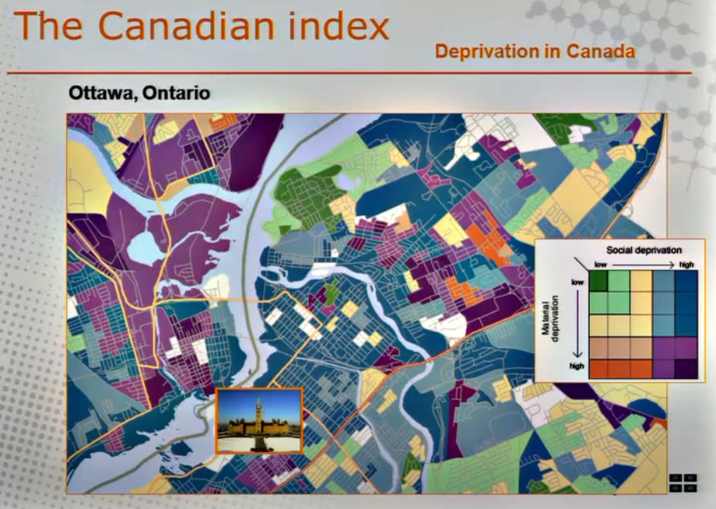
And Mapped…

Slide 13
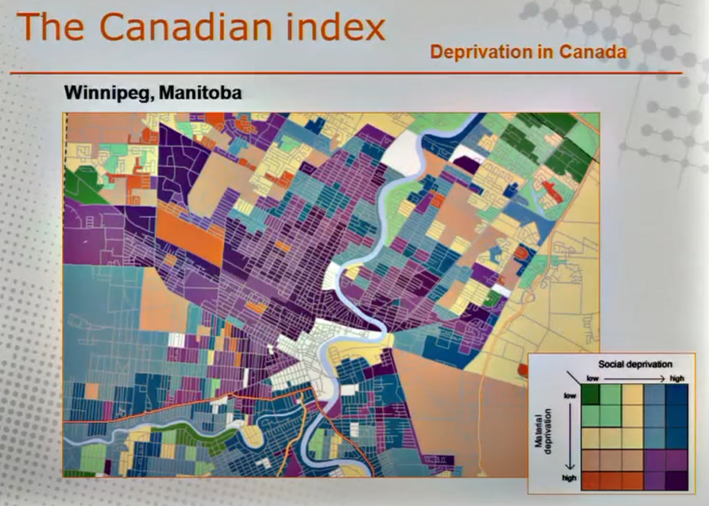

Slide 14
Research Question

Slide 15
My Research Question is…
If Obesity is linked to Food Swamps & Deserts, I’d like to find out if the “the variables that make up the Social Deprivation Index score also corresponds with the ones for food insecurity for a given US county?”

Slide 16
Proposed Method
Statistical Tools
Explore the Dataset with PCA
Multi-variate Linear Regression
Divide into Training and Testing Data
What I expect to find
That Deprivation & Food Insecurity are linked

Slide 17
Data
SDI Data
Data originally from American Community Survey (ACS)
30 Variables, 3143 Rows
Link
USDA Data
From the US Department of Agriculture
281 Variables, 3143 Rows
Link

Slide 18
Conclusion
Poverty is Invisible
Maps are illuminating
Obesity may also be a symptom of larger problems with inequality.

Slide 19
References
SDI in Quebec
Townsend deprivation index - WikiMili, The Free Encyclopedia
Development and use of a National Deprivation index – YouTube
Food Swamps Predict Obesity Rates Better Than Food Deserts in the United States - PMC (nih.gov)
Food Swamps: https://external-content.duckduckgo.com/iu/?u=https%3A%2F%2Ftse1.mm.bing.net%2Fth%3Fid%3DOIP.5IXnxO_2UaTvjTMubbMT6wHaE8%26pid%3DApi&f=1

